Slide 1






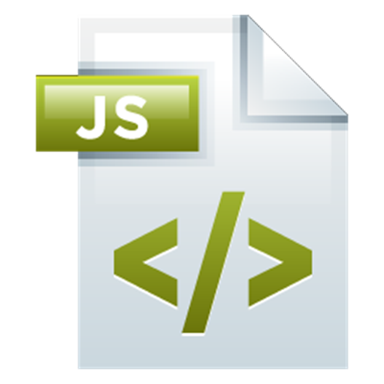
Router
SPA Navigation
React.js Development
SoftUni Team
Technical Trainers
Software University
http://softuni.bg

Slide 2

Table of Contents
Route Configuration
Redirects & Not Found
Links
Params & Querystrings
Programmatic Redirects
Private Routes

Slide 3
Have a Question?
sli.do #react-js

Slide 4
Route Configuration
Registering Our Routes

Slide 5
Route Configuration
First install the react-router package
It gives you the following
BrowserRouter – handles the routes
Switch – container for routes
Route – specify a route path
Link – gives you a link to a path
Redirect – redirect to another route
npm install react-router-dom --save

Slide 6
Route Configuration
Create a Routes.js for centralized route configuration
import { Route, Switch, Redirect } from 'react-router-dom'
// code skipped for brevity
const Routes = () => (
<Switch>
<Route exact path='/' component={HomePage} />
<Route path='/home' component={HomePage} />
<Route path='/render' render={props => (
<div>From render</div>
)} />
<Redirect from='/about-us' to='/about' /> // redirects a route
<Route component={NotFoundPage} /> // not path – matches *
</Switch>
)
export default Routes

Slide 7
Route Configuration
Add the Routes component somewhere (App.js for example)
class App extends Component {
render () {
return (
<div className='App'>
<Header />
<Routes />
</div>
)
}
}

Slide 8
Route Configuration
Then render the BrowserRouter (or HashRouter)
Check the official documentation for more information: https://reacttraining.com/react-router/web/guides/philosophy
import { BrowserRouter } from 'react-router-dom'
// code skipped for brevity
ReactDOM.render(
<BrowserRouter>
<App />
</BrowserRouter>,
document.getElementById('root'))

Slide 9
Links
Easy Site Navigation

Slide 10
Links
If you are using a normal a tag, your page will be refreshed
React comes with built-in links to use with the router
import { Link } from 'react-router-dom'
// code skipped for brevity
<Link to='/home'>Home</Link>
<Link to='/about'>About</Link>
<Link to={'/path/with' + id}>Parameter path</Link

Slide 11
Params & Querystrings
Adding Additional Information

Slide 12
Params & Querystrings
Adding parameters to the route is very easy
<Route path='/my/route/:id/:name' component={SomePage} />
class ParamsPage extends Component {
render () {
let params = this.props.match.params
let id = params.id
let name = params.name
return (
<div>
Parameter {id} {name}
</div>
)
}
}

Slide 13
Params & Querystrings
Querystrings require external package
For example query-string
Then it's easy
npm install query-string --save
import queryString from 'query-string'
let query = queryString.parse(this.props.location.search)
// ?name=Test&key=value
// {
// name: 'Test'
// key: 'Value'
// }

Slide 14
Programmatic Redirects
How To Redirect From Code

Slide 15
Programmatic Redirect
For programmatic redirect, you can use the history option
class HomePage extends Component {
constructor (props) {
super(props)
this.redirectPage = this.redirectPage.bind(this)
}
redirectPage () {
this.props.history.push('/about')
}
render () {
return (
<div>
<button onClick={this.redirectPage}>Change Route</button>
</div>
)
}
}

Slide 16
Private Routes
For private routes, you need to create your own component
const PrivateRoute = ({component: Component, ...rest}) => (
<Route {...rest} render={props => (
Auth.isAuthenticated ? (
<Component {...props} />
) : (
<Redirect to={{
pathname: '/login',
state: { from: props.location }
}} />
)
)
} />
)

Slide 17








JavaScript Web – React.js Fundamentals
https://softuni.bg/trainings/1434/node-js-development-september-2016

Slide 18

License
This course (slides, examples, demos, videos, homework, etc.) is licensed under the "Creative Commons Attribution-NonCommercial-ShareAlike 4.0 International" license
Attribution: this work may contain portions from
"End-to-end JavaScript Applications" course by Telerik Academy under CC-BY-NC-SA license

Slide 19





Free Trainings @ Software University
Software University Foundation – softuni.org
Software University – High-Quality Education, Profession and Job for Software Developers
softuni.bg
Software University @ Facebook
facebook.com/SoftwareUniversity
Software University @ YouTube
youtube.com/SoftwareUniversity
Software University Forums – forum.softuni.bg

